Slide 1
Machine Learning

Slide 2
Outline
Introduction
Supervised Learning
Classification Problem
Classification by Similarity - Nearest neighbor Algorithm (k-NN)
Classification by Boundary-Decision (Perceptron Algorithm, SVM)
Unsupervised Learning
Clustering Problem
K-mean Algorithm
Reinforcement Learning
Q-Learning Algorithm

Slide 3
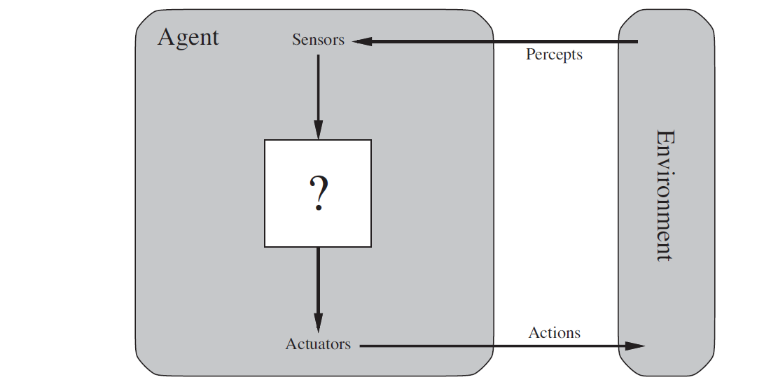
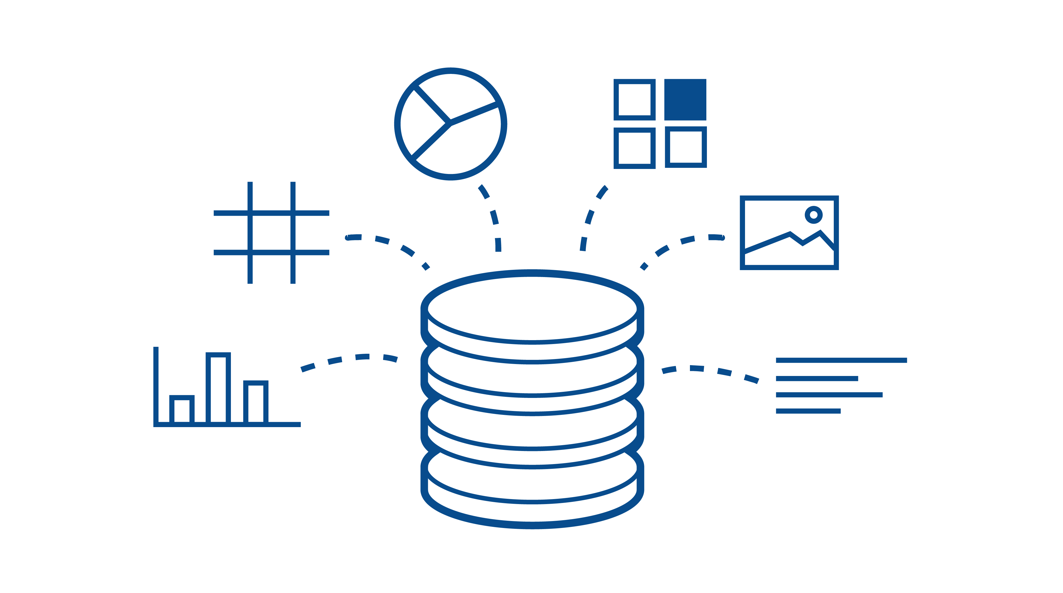
Problem Solving through Learning
So far in this class … An AI solves problems following specific instructions or algorithms
Searching for a solution (Searching, CSP, Logic)
Others (Generate and Test, Problem Reduction, ..etc.)
This topic is about solving problems through Learning
Machine Learning: Let the computer learn from provided data or feedback, rather than giving explicit instructions
Similar to how a human learns to perform tasks

Slide 4

AI and Machine Learning
https://www.intel.com/content/www/us/en/developer/articles/guide/ai-practitioners-guide-for-beginners.html

Slide 5
Machine Learning Approaches
Machine learning main approaches:
Supervised learning: The computer is presented with example inputs and their desired outputs, and the goal is to learn a general function/model that maps any input to the correct output.
Unsupervised learning: No labels are given to the learning algorithm, leaving it on its own to find structure in its input.
discovering hidden patterns in data
Reinforcement learning: A computer program interacts with a dynamic environment in which it must perform a certain goal (such as driving a vehicle or playing a game against an opponent). As it navigates its problem space, the program is provided feedback that's analogous to rewards, which it tries to maximize.

Slide 6
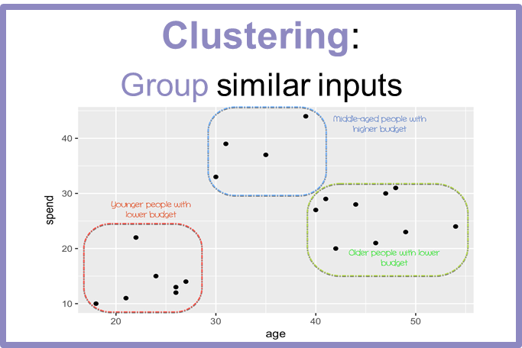
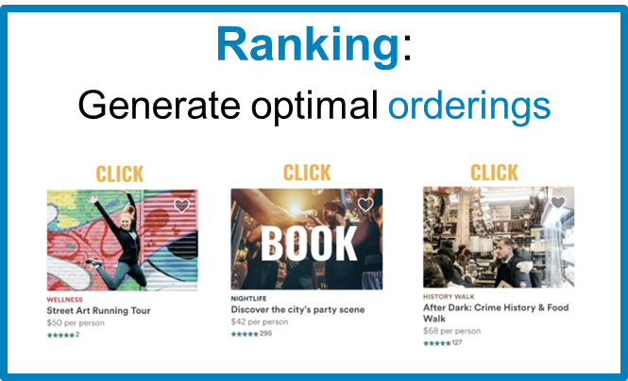
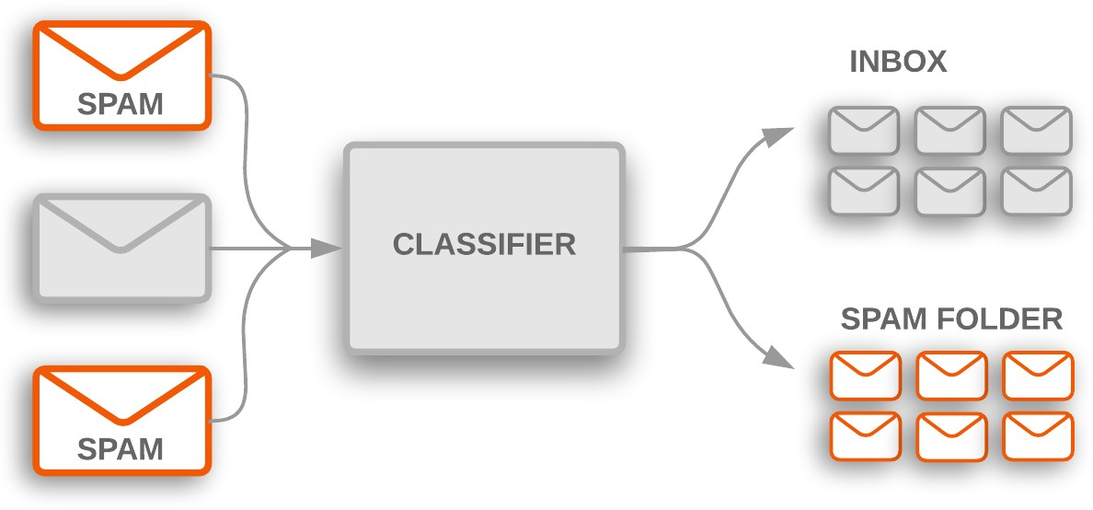
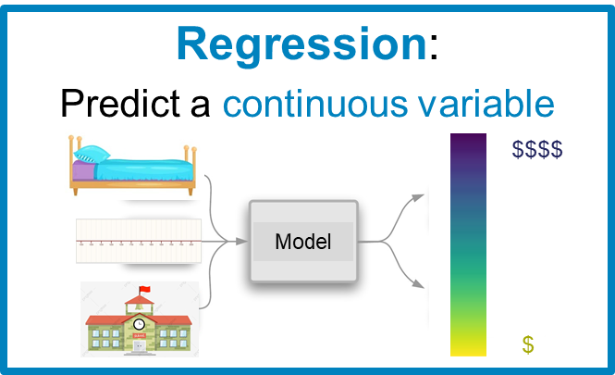
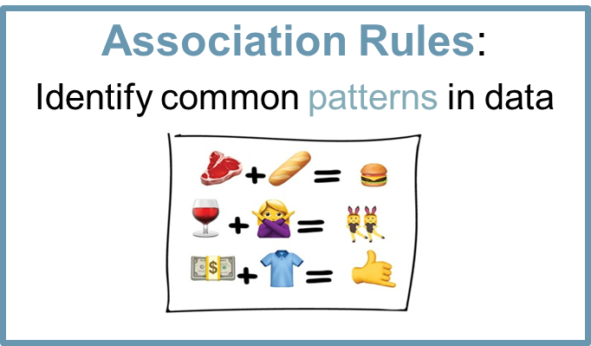
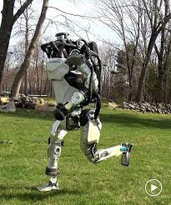
Typical Problems for ML?
Classification:
Predict a class label for an input
Reinforcement Learning

Slide 7
Supervised Learning (SL)

Slide 8

Supervised Learning
Given a dataset of input-output pairs, learn a function or model to map inputs to outputs
Examples: handwritten numbers recognition
Dataset contains examples of how each number is written.
Dataset
(input-output) examples
Learn how inputs are mapped to output

Slide 9
Supervised Learning - Classification
Classification is one of the most important problems solved by SL.
The computer learns to classify things into categories based on given examples
Similar to how students learn from solved examples.
Specifically, classification is a supervised learning task of learning a function/model that maps an input point to a discrete category
Such function/model is also called a classifier

Slide 10
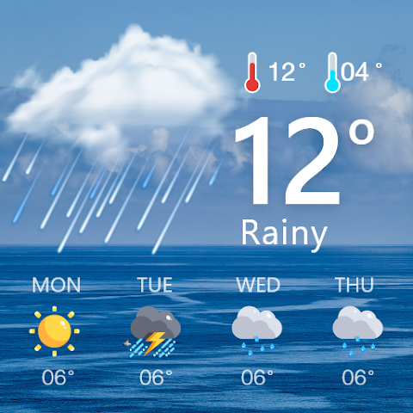
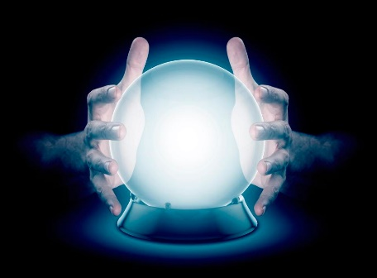
Supervised Learning - Classification
Example: Predicting Weather
Is it going to rain tomorrow or not?
Can you tell based on historical data?
Given labeled data pairs of [temperature, humidity, ..] <-> rain or not
Can you come up with a Function/Model to predict the weather?
Predict = classify a certain day into raining or not raining
Question: how many classes are there in this example?

Slide 11
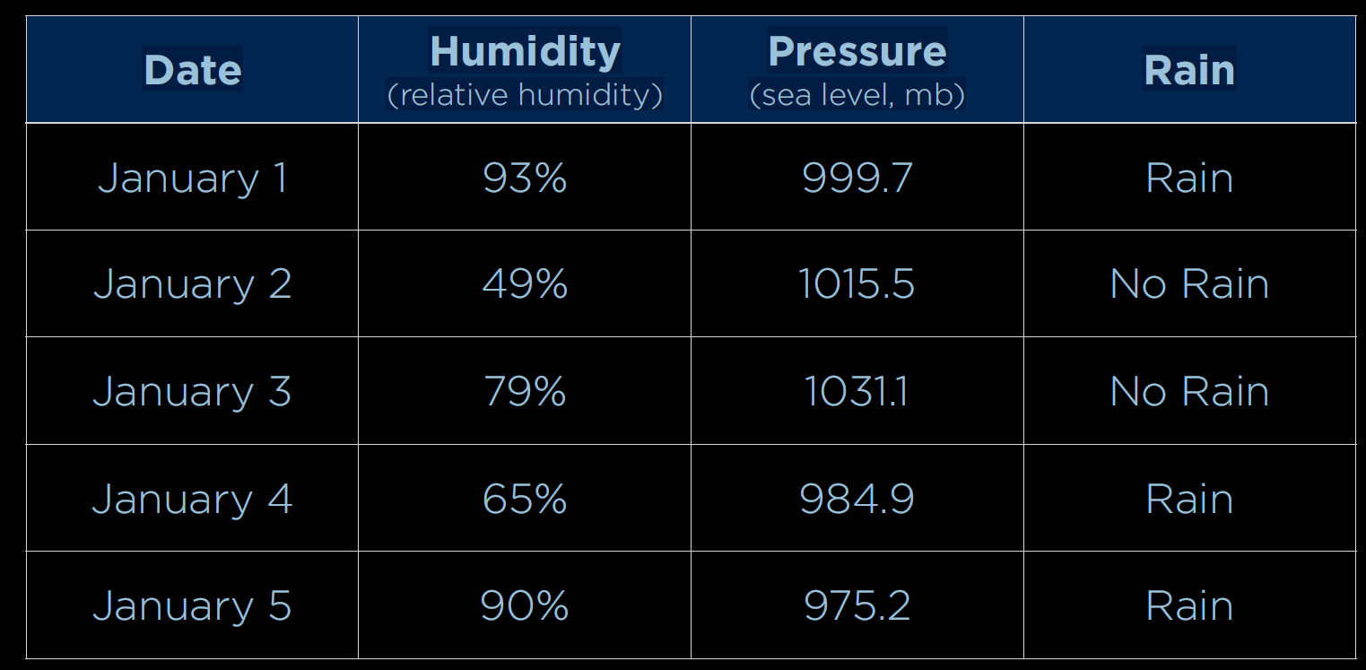
Classification Example – Predicting Weather
features
label/class
Supervised learning:
Computer learns from given data instances in the form of (features, class)
Come up with an estimate of function f(humidity, pressure) = class
f(93, 999.7) = Rain, f(49, 1015.5) = No Rain , …etc.

Slide 12
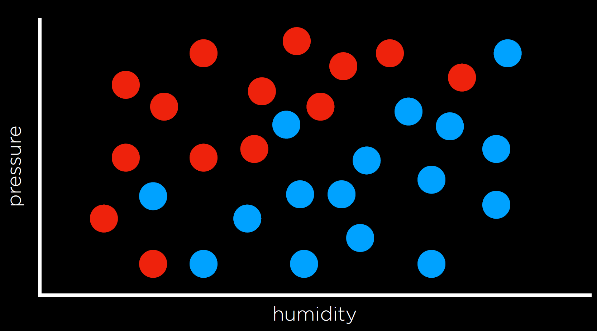
Classification Example – Predicting Weather
Towards predicting weather
Plot the data
Each point represents the (humidity, pressure) of a given day
Points colored either
Blue if that day was rainy, or
Red if the day was not rainy.
Questions:
Plot is 2-D - why?
What if there are more classes?
What if there are more features?
Rain
No Rain

Slide 13
Classification Example – Predicting Weather
Classification Problem
Given a new data point without a known class
What is the class of the new point?
Goal: Training the computer to do classification automatically
Example:
What is the class of the shown new data point (white)? Rain or No Rain?
Why?
What approach would you use?
?
Rain
No Rain

Slide 14
Classification Approaches
Classification By Similarity
Nearest Neighbor Algorithm (NN)
Classify a new point based on the class of its nearest neighbor
Example:
The new point is classified as blue (Rain).
Its nearest neighbor is a blue point
?
Rain
No Rain

Slide 15
Classification Approaches
Classification By Similarity
Nearest Neighbor Algorithm (NN)
Classify a new point based on the class of its nearest neighbor
Example:
How about the new shown point?
?
Rain
No Rain

Slide 16
Classification Approaches
Classification By Similarity
Nearest Neighbor Algorithm (NN)
Classify a new point based on the class of its nearest neighbor
Example:
How about the new shown point?
The new point is classified as red (No Rain).
Its nearest neighbor is a red point
?
Rain
No Rain

Slide 17
Classification Approaches
Classification By Similarity
Nearest Neighbor Algorithm (NN)
Classify a new point based on the class of its nearest neighbor
Example:
How about the new shown point?
Is it blue (Rain) or red (No Rain)?
?
Rain
No Rain

Slide 18
Classification Approaches
Classification By Similarity
k-Nearest Neighbor Algorithm (NN)
Classify based on k nearest neighbors
Shown example – classification based on 3 nearest neighbors
Question: What is the class? Is it Red or Blue?
?
Rain
No Rain

Slide 19
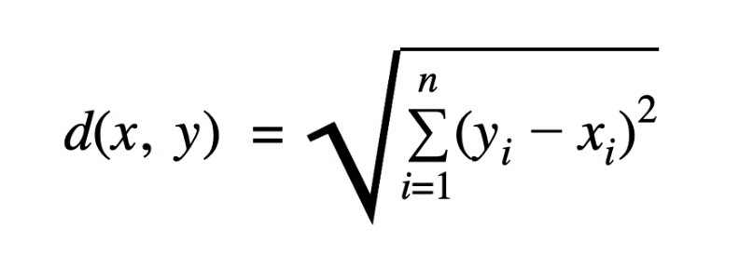
k-Nearest Neighbor Algorithm (k-NN)
Measuring Similarity
k-NN requires a function to calculate the similarity between any two points
Needed to find the nearest neighbors of a given unclassified point
Euclidean distance d(x, y)
x = (x₁, x₂, .., x_{n})
y = (y₁, y₂, …, y_{n})
?
Rain
No Rain

Slide 20
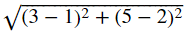
k-Nearest Neighbor Algorithm (k-NN)
Euclidean distance d(x, y)
x = (x₁, x₂, .., x_{n})
y = (y₁, y₂, …, y_{n})
Example (2-D): Find the distance between 𝑥=(3,5) and y=(1,2).
d(x, y) = = 3.6
?
Rain
No Rain

Slide 21
k-Nearest Neighbor Algorithm (k-NN)
Worked Example: Given the following 4 labeled data points, classify (3,7) using K-NN.
X1 | X2 | Y | Euclidean distance to query instance (3,7) | Rank minimum distance | Is it included in 3-NN | Y= category of nearest neighbour
7 | 7 | Bad | √(7-3)^2+(7-7)^2=4 | 3 | yes | Bad
7 | 4 | Bad | √(7-3)^2+(4-7)^2=5 | 4 | no | -
3 | 4 | Good | √(3-3)^2+(4-7)^2=3 | 1 | yes | Good
1 | 4 | Good | √(1-3)^2+(4-7)^2=3.6 | 2 | yes | Good
3 | 7 | ? | We have 2 good and 1 bad then we conclude that the new sample is included in Good category
Query Instance

Slide 22
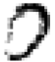
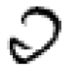
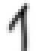


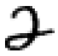
Nearest-Neighbor (k-NN)
Nearest neighbor for digits images:
Take new image
Compare to all training images
Assign based on closest example
Encoding: image is vector of intensities:
The intensities range from 0 to 1, where 0 represents white and 1 represents black.
What’s the similarity function?
Dot product of two images vectors?
0
1
2
0
1
2

Slide 23
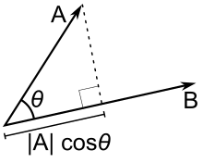
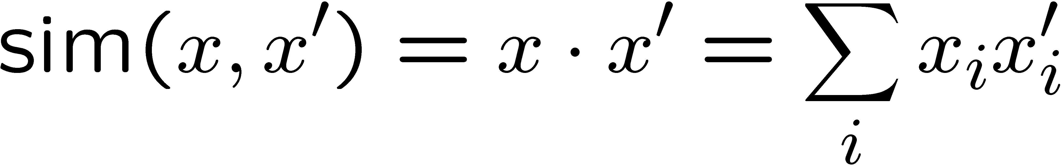
Nearest-Neighbor (k-NN)
What’s the similarity function?
Dot product of two images vectors?
x⋅x’=|x||x’|cos θ
Usually normalize vectors so |x| = 1, where |x| denotes the magnitude of a vector, where |x|=sqrt(x⋅x). (square root of the dot product of x with itself).
min = 0 (when?), max = 1 (when?)
The dot product calculation is straightforward (the simplest) — and this gives us benefits in terms of computation time

Slide 24
k-Nearest Neighbor Algorithm (k-NN)
Pros
Simple algorithm to implement
Does not require training a model apriori
Cons
Slow in classifying a new point
requires measuring distances to every training example
Not efficient with high dimensional data
k-NN Demo
https://martin-thoma.com/k-nearest-neighbor-classification-interactive-example/

Slide 25
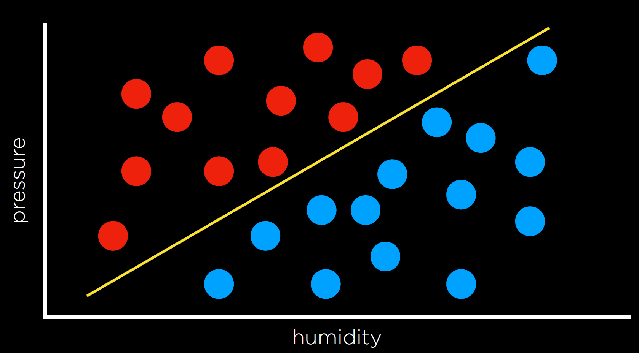
Other Classification Approaches
So far …
Classification was done by comparing a new point to its neighbors using the k-NN Algorithm
Are there other approaches?
Rain
No Rain

Slide 26
Other Classification Approaches
Classification By creating Decision Boundary between classes
A new point is classified based on where it falls relative to a decision boundary
Example (Weather):
The yellow line represents one possible decision boundary
separates rainy days from non-rainy days
Blue (Rain) points below the line
Red (No Rain) points above the line
What is the class of the shown new points?
?
?
Rain
No Rain

Slide 27
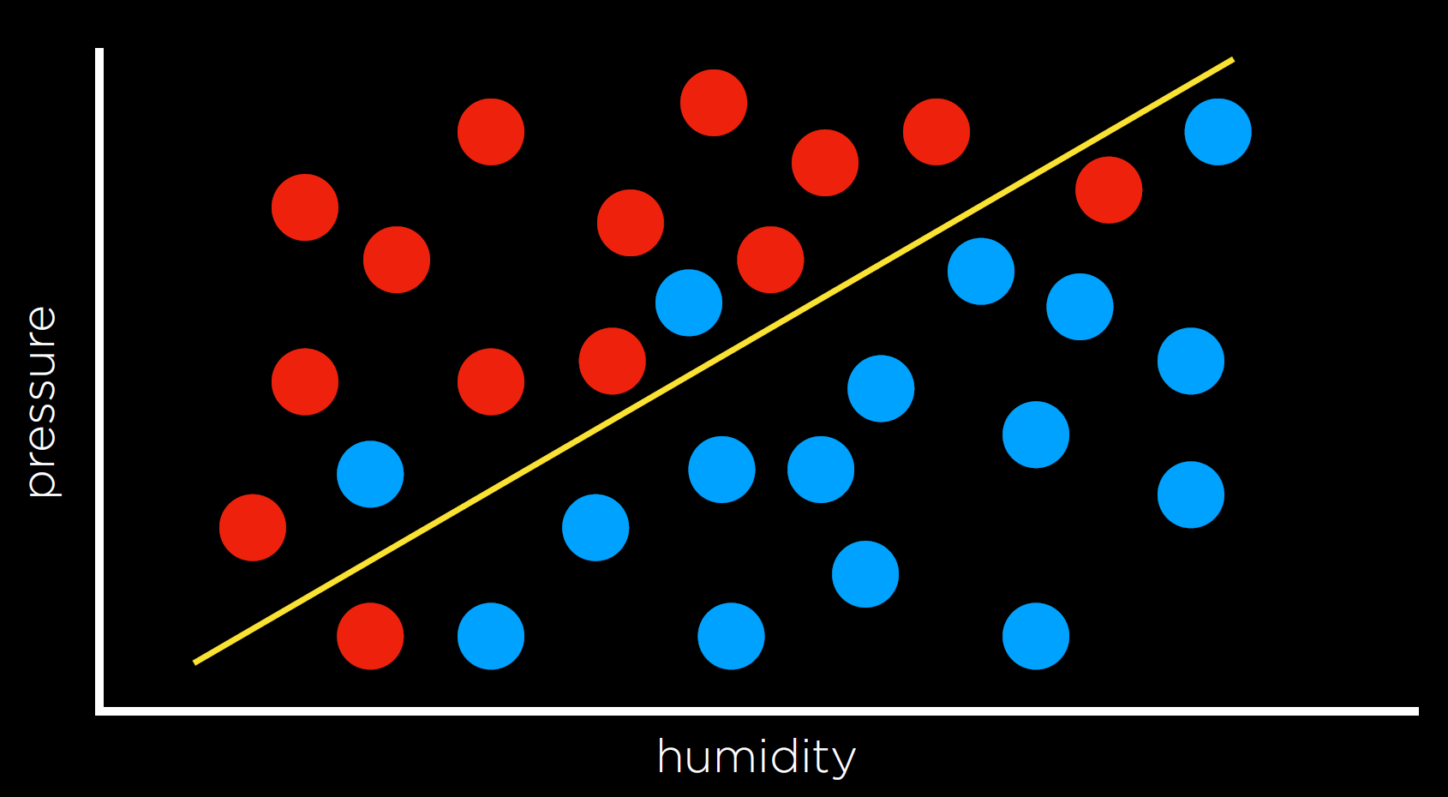
Other Classification Approaches
Classification By creating Decision Boundary between classes
Several algorithms can be used to find the best decision boundary
decision boundary in 2-D is a line, in 3-D, is a plane, and in n-D, is a hyperplane
Caveat: data points may not be completely separable
In general, goal is to find the best possible decision boundary
Need to compare different possible decision boundaries
Question: Is the shown line the best one? Why?
Rain
No Rain

Slide 28
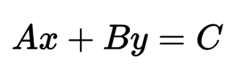
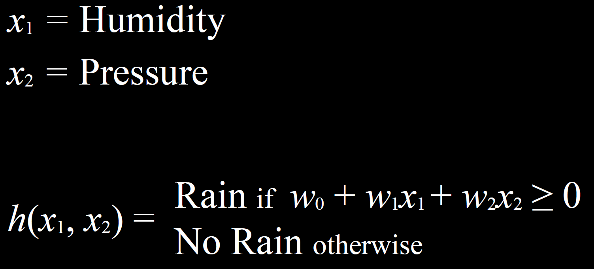
Decision Boundary – Perceptron Algorithm
Finding the best Decision Boundary
Let’s consider the 2-D case
The decision boundary is a line h
Different weights give different lines
How to find the best line?
Rain
No Rain

Slide 29
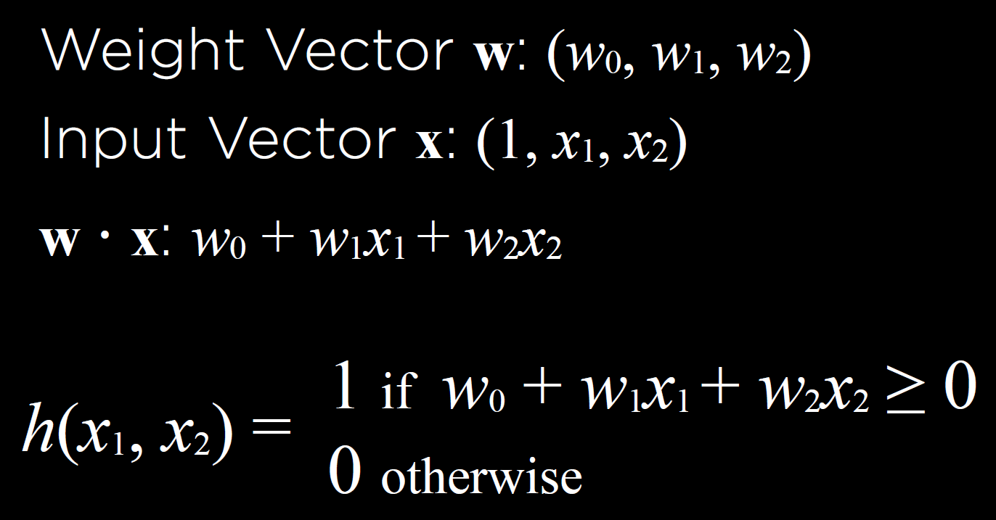
Decision Boundary – Perceptron Algorithm
Finding the best Decision Boundary
Using vector notation
Using 1 for Rain, 0 for No Rain
Rain
No Rain

Slide 30
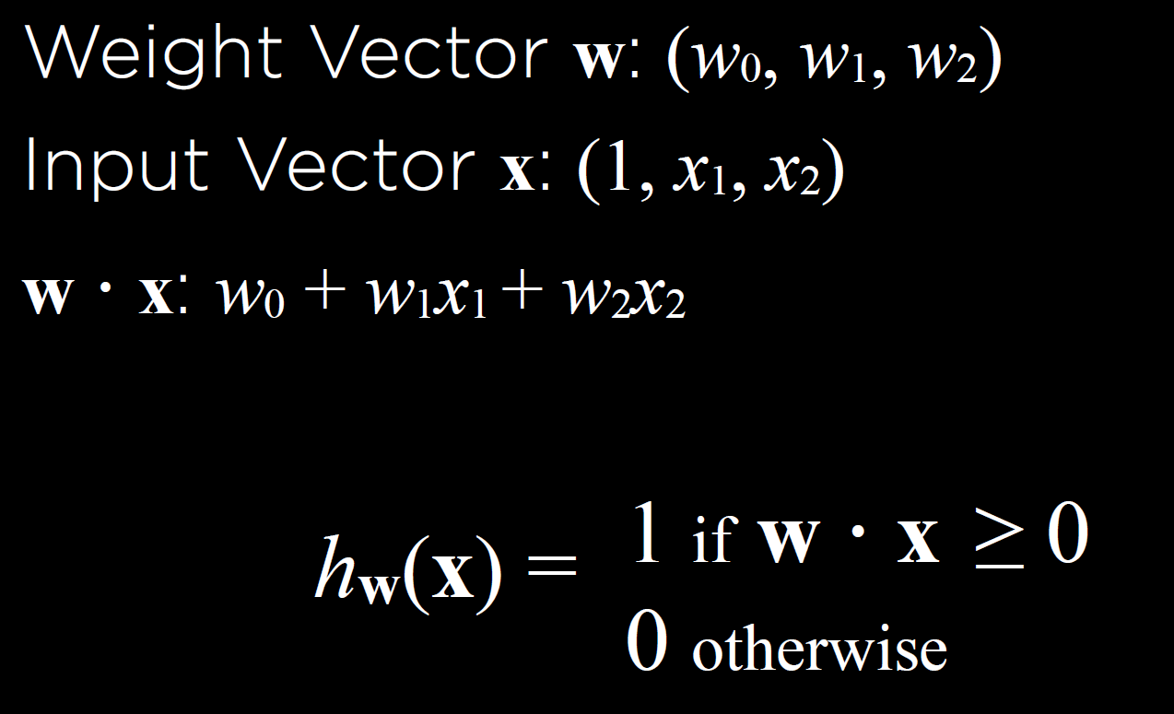
Decision Boundary – Perceptron Algorithm
Finding the best Decision Boundary
More compact vector form
Rain
No Rain

Slide 31
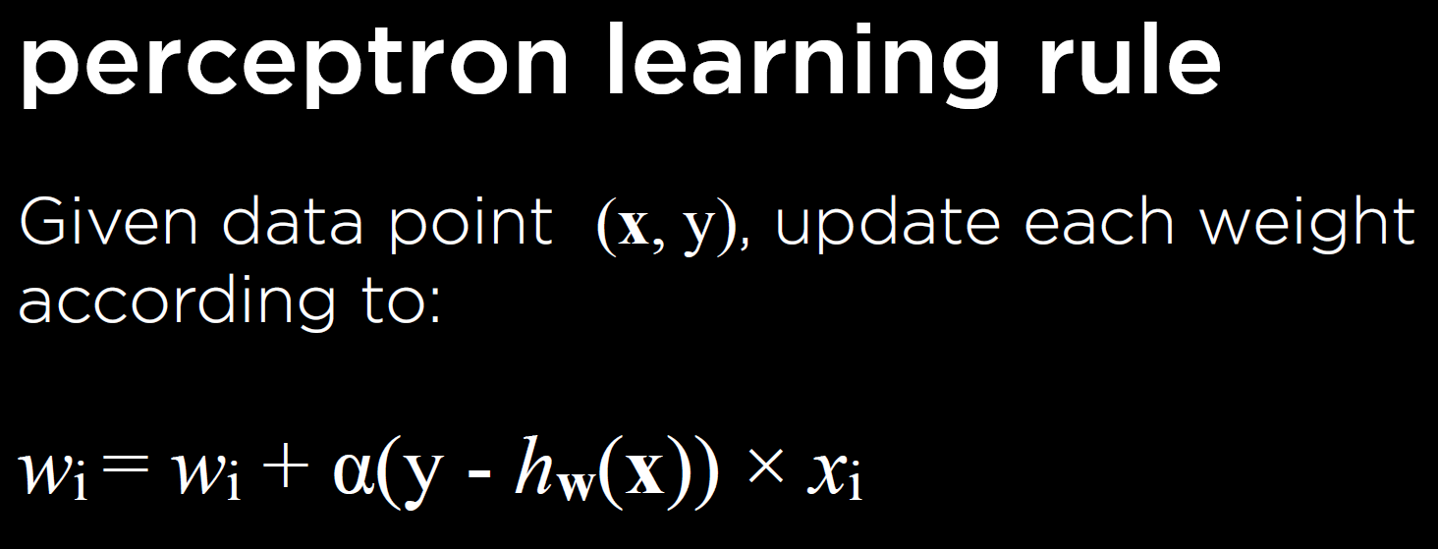
Decision Boundary – Perceptron Algorithm
x: (pressure, humidity) – data point
y: 1 or 0 – class
α: learning rate – controls weight updates
Rain
No Rain

Slide 32
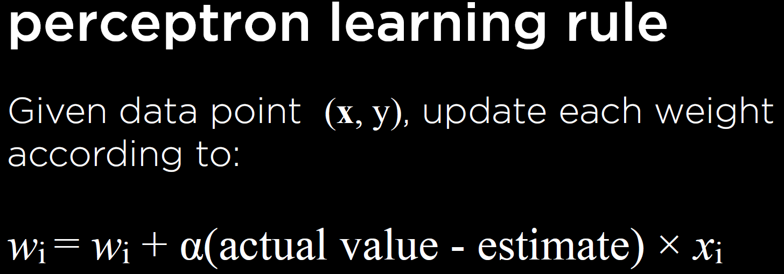
Decision Boundary – Perceptron Algorithm
If actual value > estimate, weight update is positive
Increase estimate
If actual value < estimate, weight update is negative
decrease estimate
Rain
No Rain

Slide 33
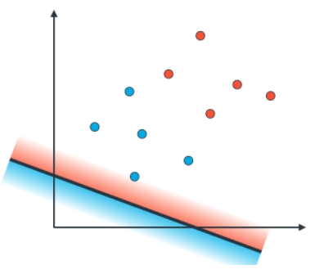
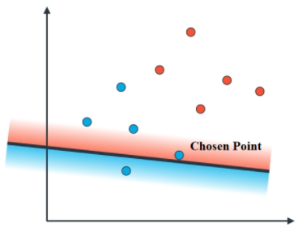
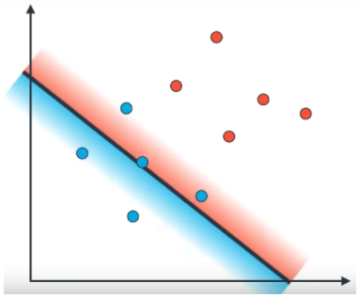
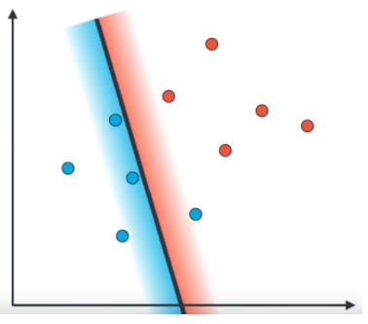
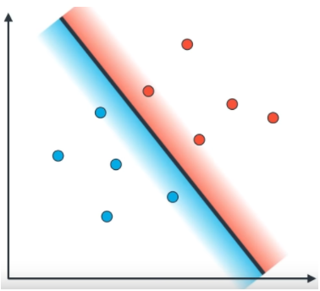
Decision Boundary – Perceptron Algorithm
Step 1
Step 2
Step 3
Step 4
Step 5

Slide 34
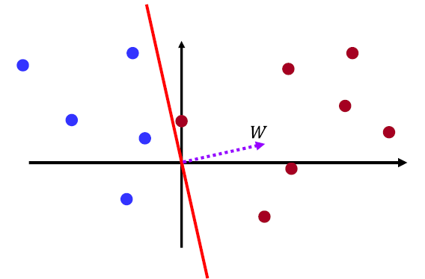
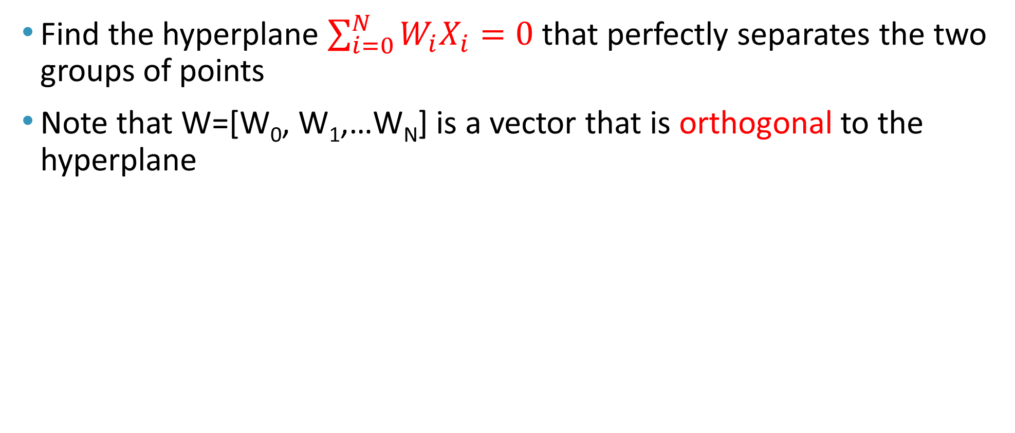
Perceptron Learning Algorithm
Find the hyperplane $\sum_{i=0}^{N}{W_{i}X_{i}=0 }$that perfectly separates the two groups of points
Note that W=[W₀, W₁,…W_{N}] is a vector that is orthogonal to the hyperplane
Note that W.X is the vector
dot product = |W| |X| Cos θ,
where θ is the angle between
vectors W and X.

Slide 35
Perceptron Learning Algorithm
Given training instances (X₁, Y₁), (X₂, Y₂), …, (X_{N}, Y_{N})
Initialize W
Do
For i = 1 to N
if ( Y_{i} > h(X_{i}) )
W = W + α X_{i}
else if ( Y_{i} < h(X_{i}) )
W = W - α X_{i}
Until no classification errors
Note that X_{i} represent input samples

Slide 36
Perceptron Learning Algorithm: Example
Initialize: Randomly initialize the hyperplane (i.e. randomly initialize the normal vector W)
Classification Rule:
Vectors on the same side of the hyperplane as W will be assigned 1 class, and those on the other side will be assigned 0

Slide 37
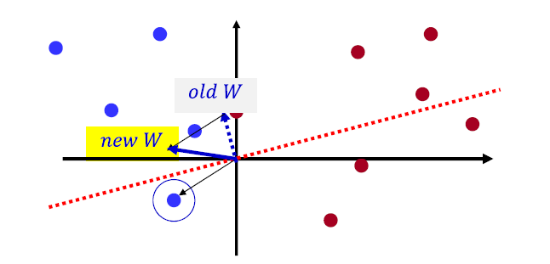
Perceptron Learning Algorithm: Example
Misclassified blue instance
Updated weight vector
Misclassified blue instance,
add it to W

Slide 38
Perceptron Learning Algorithm: Example
Misclassified red instance
Perfect classification,
no more updates
Updated hyperplane
Updated hyperplane
Misclassified red instance,
subtract it from W

Slide 39
Perceptron Classifier (updating weights example)
-Current weight vector: W=(2,-1,1), -Training data points: as shown in the table, -Perceptron update α = 0.1
For each training instance:
Classify with current weights: If correct (i.e., target=predicted), no change!, If wrong: adjust the weight vector
F(X) features |  |  | Y(Actual) | W0 W1 W2 | Predicted | Update weights
x0 | x1 | x2 |  | 2 -1 1
1 | 1 | 1 | 1 | No update 2 -1 1 | 1*2+1*-1+1*1 = 2>0 (matching the target) | Target=1, predicted=1 (no update)
1 | 2 | 0.4 | 0 | After updating step 1.9 -1.2 0.96 | 1*2+ 2*-1 + 0.4*1 = 0.4 >0 means it is 1, (Not matched) | W+0.1*(0-1)*X=W-0.1*X W0=2-0.1*1=1.9 W1=-1-0.1*2=-1.2 W2= 1-0.1*0.4=0.96
1 | -2 | 0 | 1 | No update 1.9 -1.2 0.96 | 1*1.9-2*-1.2+0*0.96=4.3 >0 (matching the target) | Target=1, predicted=1 (no update)

Slide 40
Perceptron Classifier (updating weights example)
-Perceptron update α =0.1
For each training instance:
Classify with current weights: If correct (i.e., target=predicted), no change!, If wrong: adjust the weight vector
F(X) features |  |  | Y(Actual) | W0 W1 W2 | Predicted | Update weights
x0 | x1 | x2 |  | 1.9 -1.2 0.96
1 | 1 | 1 | 1 | No update 1.9 -1.2 0.96 | 1*1.9+1*-1.2+1*0.96 = 1.66>0 (matching the target) | Target=1, predicted=1 (no update)
1 | 2 | 0.4 | 0 | No update 1.9 -1.2 0.96 | 1*1.9+ 2*-1.2 + 0.4*0.96 = -0.1116<0 means it is 0, (matching the target) | Target=0, predicted=0 (no update)
1 | -2 | 0 | 1 | No update 1.9 -1.2 0.96 | 1*1.9-2*-1.2+0*0.96=4.3 >0 (matching the target) | Target=1, predicted=1 (no update)

Slide 41
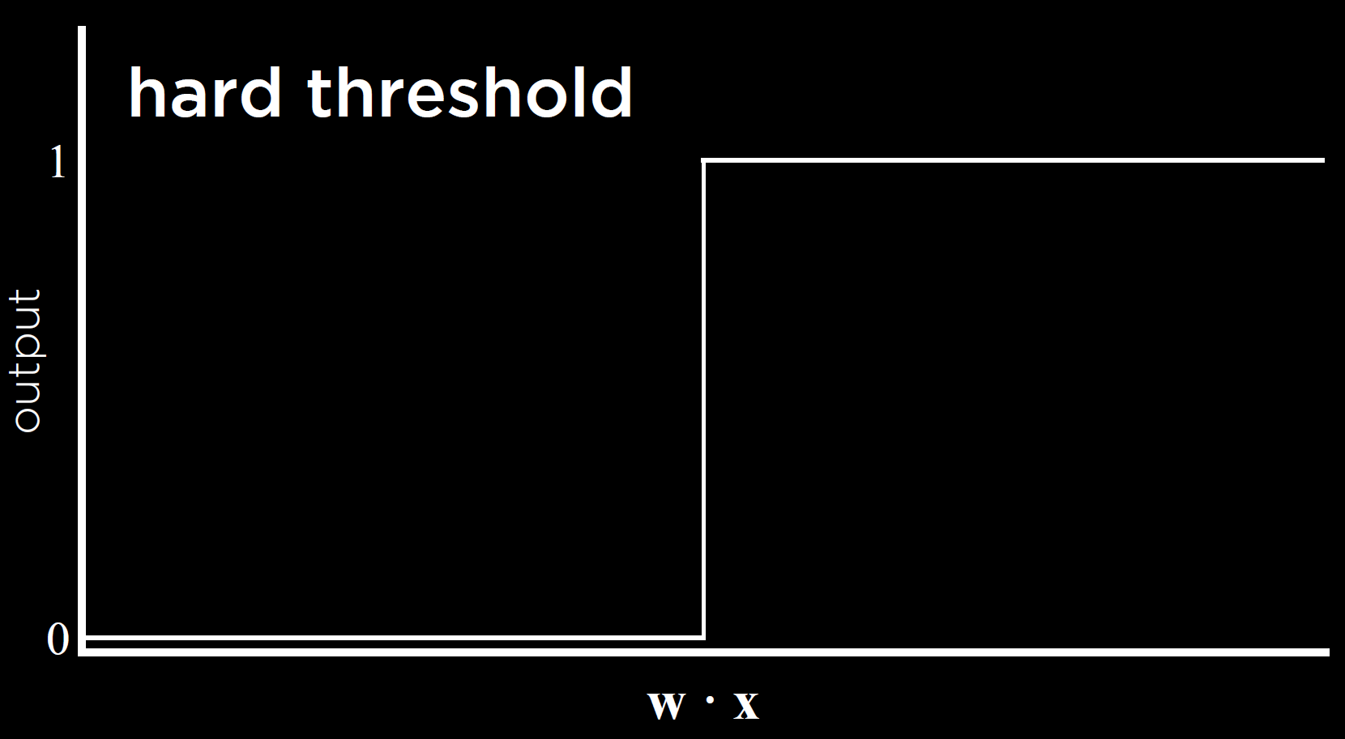
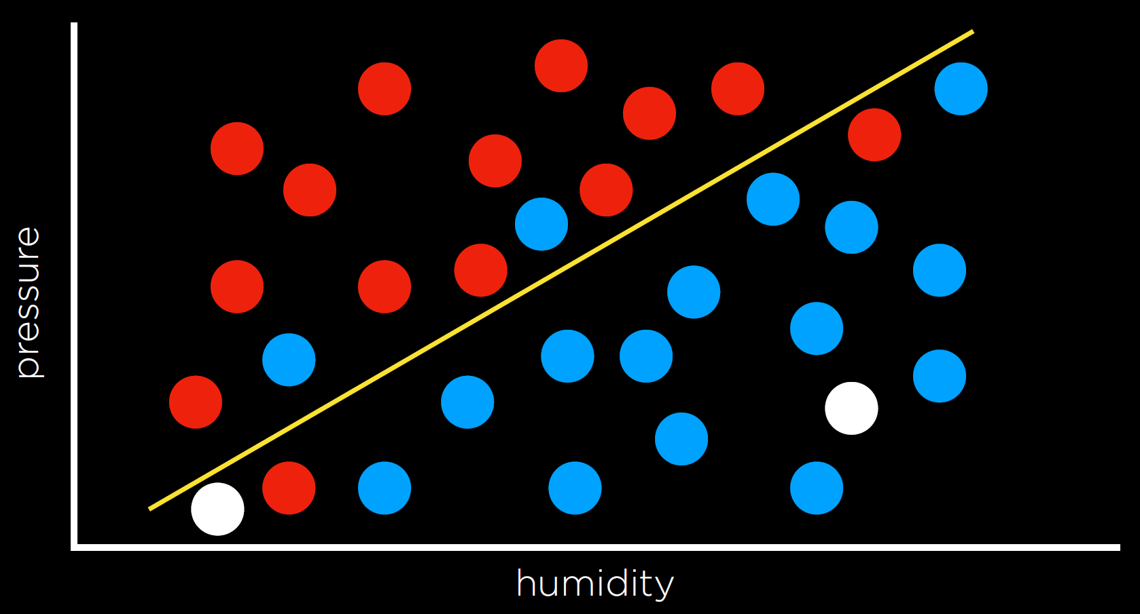
Decision Boundary – Perceptron Algorithm
Decision boundary line is essentially a threshold function (0 or 1)
Question:
How accurate is the classification of the two shown points 1 and 2?
How confident?
2
1

Slide 42
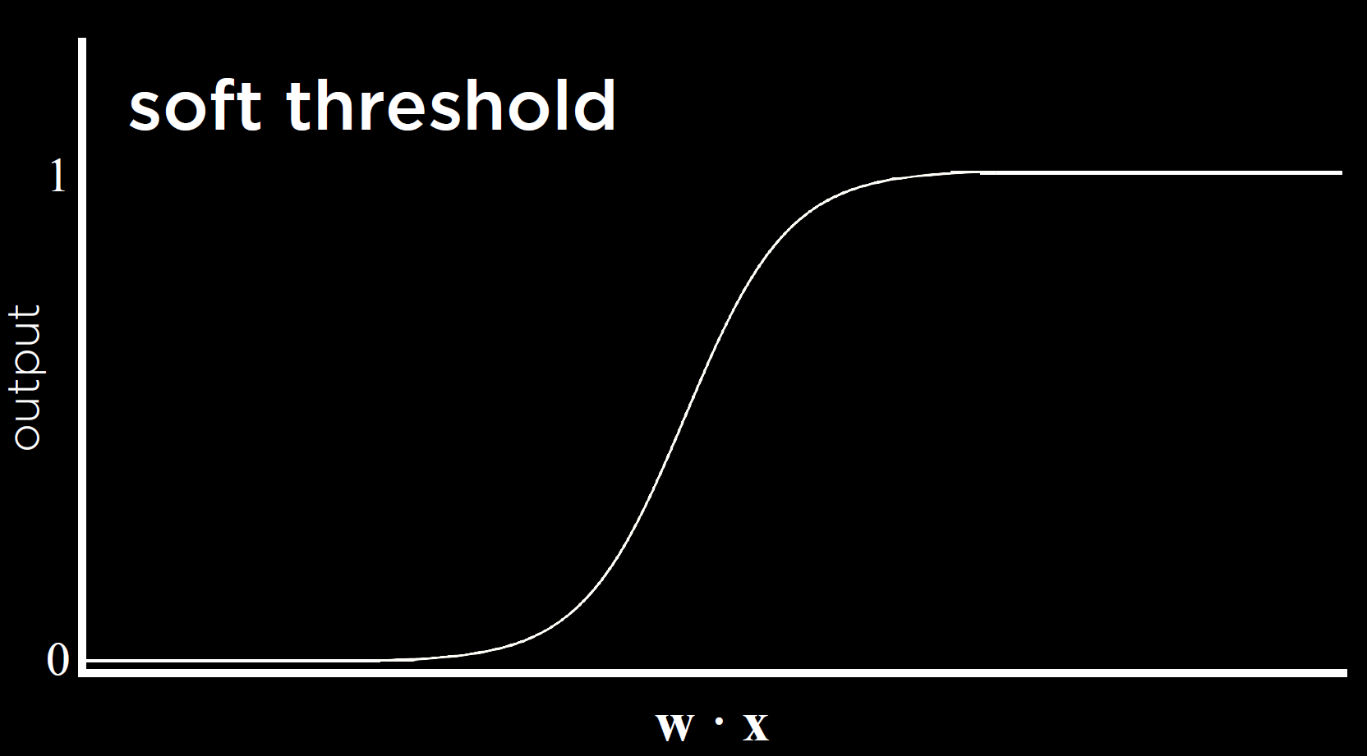
Decision Boundary – Perceptron Algorithm
Soft threshold
Output is a real number (0,1)
Logistic function
More about this later …
2
1

Slide 43
Problems with the Perceptron
Noise: if the data isn’t separable, weights might thrash
Averaging weight vectors over time can help (averaged perceptron)
Mediocre generalization: finds a “barely” separating solution

Slide 44
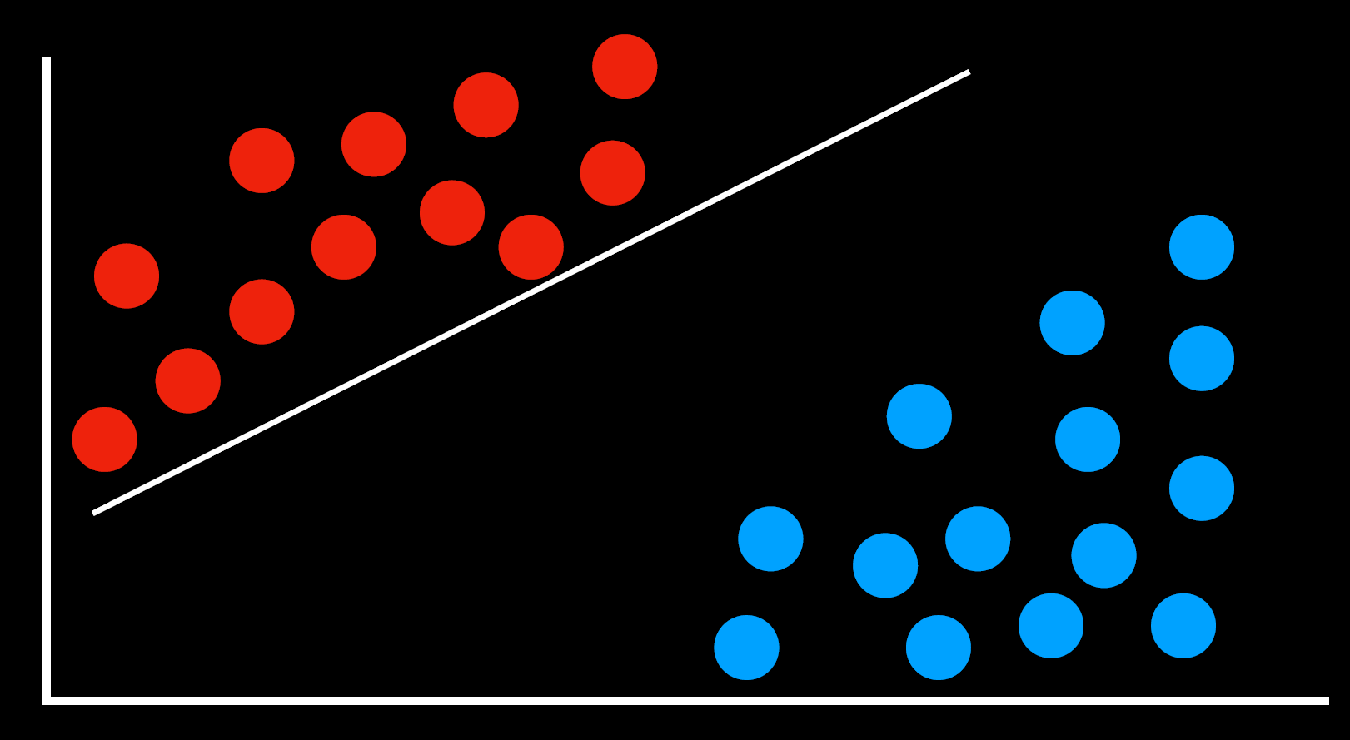
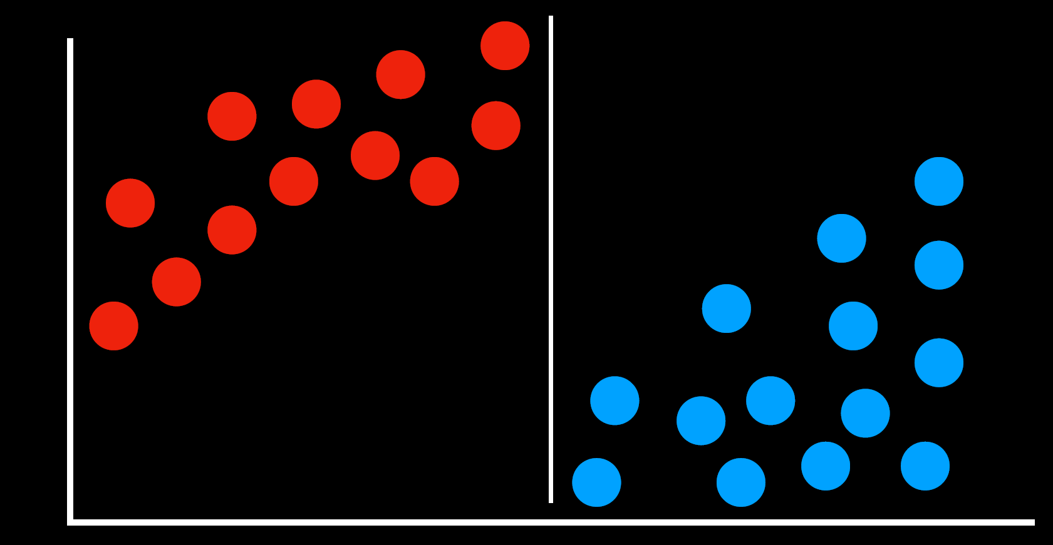
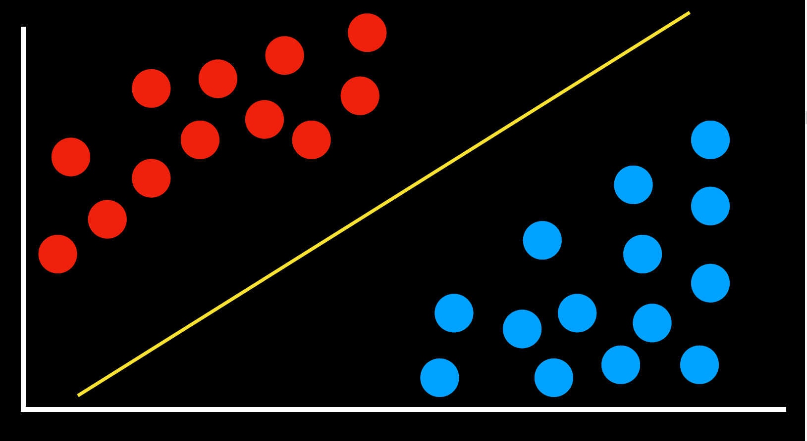
Decision Boundary – Support Vector Machines
Support Vector Machines (SVM)
A popular algorithm to calculate decision boundaries between classes
Consider the shown data..
Which of the 3 boundary lines is considered the best? Why?
2
1
3

Slide 45
Decision Boundary – Support Vector Machines
Support Vector Machines (SVM)
Finds a maximum margin separator - i.e., boundary that maximizes the distance between any of the data points
Unlike the perceptron algorithm which finds any separator

Slide 46
Decision Boundary – Support Vector Machines
Support Vector Machines (SVM)
Support Vectors are those datapoints that the margin pushes up against
Together, the two support vectors form the margin
Maximum margin linear classifier is the linear classifier with the maximum margin
margin
Support vectors

Slide 47
Decision Boundary – Support Vector Machines
SVMs maximize the margin around the separating hyperplane
The margin of example 𝑥 w.r.t. a linear separator 𝑤 is the distance from 𝑥 to the plane 𝑤⋅𝑥= 0.
d: denotes ½ of the margin width

Slide 48
Decision Boundary – Support Vector Machines
The decision function is fully specified by a (usually very small) subset of training samples, the support vectors.
Our goal is to search for a large margin classifier … SVM

Slide 49
Decision Boundary – Support Vector Machines
The optimization algorithm to generate the weights proceeds in such a way that only the support vectors determine the weights and thus the boundary

Slide 50
Decision Boundary – Support Vector Machines
The standard way of writing our model for a SVM is z(x)=wx+b
z(x) = b + w₁x₁ + w₂x₂ + …. + w_{n}x_{n}
We define classification function g(z) as
Model for SVM:
Binary classification problem: data x∈ℝ^{𝑑}and labels y∈−1,+1
Linear classifier:
Parameters: w∈ℝ^{𝑑}and b∈ℝ
Decision boundary 𝑤.𝑥+𝑏=0
On point x, predict label y(𝑤.𝑥+𝑏)
If the true label on point x is y:
Classier correct if 𝑦(𝑤.𝑥+𝑏)>0

Slide 51
Decision Boundary – Support Vector Machines
Define the hyperplanes H such that:
w•xi+b ≥ +1 when yi=+1
w•xi+b ≤ -1 when yi= –1
H1and H2are the planes:
H1: w•xi+b = +1
H2: w•xi+b = –1
The plane H0 is the median in between, where w•xi+b =0
d+ = the shortest distance to the closest positive point
d-= the shortest distance to the closest negative point
The margin of a separating hyperplane is d+ + d–

Slide 52
Decision Boundary – Support Vector Machines
All points on H0 should have the same projection distance on W direction.
Equation for H0:

Slide 53
Decision Boundary – Support Vector Machines
Similarly, we can derive equations for H1 and H2.
SVM is a maximum margin classifier.
Let us introduce two vectors, one from the positive sample X+ and one from the negative sample X-.

Slide 54
Decision Boundary – Support Vector Machines
Let us take the difference between these two vectors and compute its dot product with the unit vector perpendicular to H0.

Slide 55
Decision Boundary – Support Vector Machines
The decision boundary should be as far away from the data of both classes as possible
We should maximize the margin, d
The total distance between H1 and H2 is thus

Slide 56
Decision Boundary – Support Vector Machines
In order to maximize the margin, we thus need to minimize||w||² with the condition that there are no data points between H1 and H2.

Slide 57
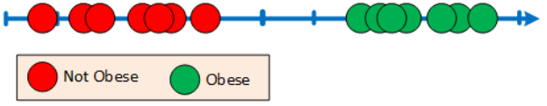
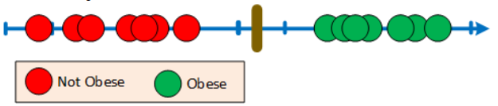
Support Vector Machines
Consider the given data representing the weight of mice where a red dot represents a non-obese mouse while a green dot represents obese mouse.
To classify a new mouse as obese or not, need to define a threshold as a cut point between being obese or not.
The distance between the edge observation of a cluster to the threshold is called a margin.
When we use the threshold that gives the maximum margin to make classification we call it Maximum Marginal Classifiers

Slide 58
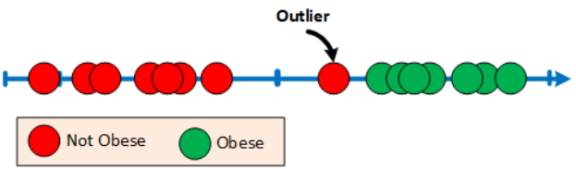
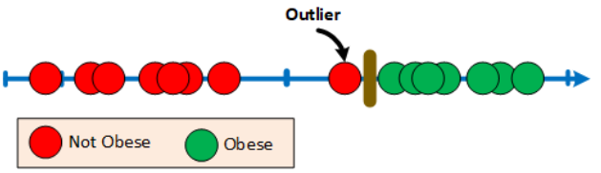
Support Vector Machines: Hard vs Soft Margin
What if our training data looked like this?
There is an outlier that will cause the Maximum Marginal Classifier to look like this.
The outlier node is classified as not obese but lies much closer to the obese.

Slide 59
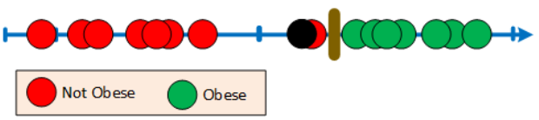
Support Vector Machines: Hard vs Soft Margin
If we try to classify a new observation shown in black, we will classify it as not obese! Although it is very far away from the not obese and closer to the obese.
The Maximum Marginal Classifiers are very sensitive to outliers.
What can we do about it?

Slide 60
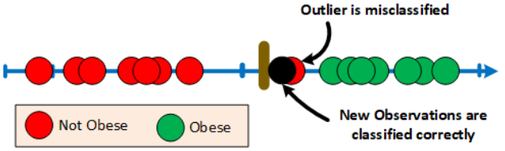
Support Vector Machines: Hard vs Soft Margin
How about if we allow some misclassification (i.e. allow some error) to help us classify new observations better.
Some misclassification may classify some training data incorrectly but increases the correct classification of the new observed data (a good trade off)
Since we allowed some misclassification, the margin is called a soft margin.
When we use a soft margin to classify the data, we often refer to it as Support Vector Classifier
Best soft margin is found using cross validation

Slide 61
Support Vector Machines: Hard vs Soft Margin
Hard margin does not allow any error.
Soft margin allows some errors.

Slide 62
Support Vector Classifiers
in 1-D, a support vector classifier is a single dot within the 1-D space.
In 2-D, a support vector classifier is a line within the 2-D space.
In 3-D, a support vector classifier is a plane or surface within the 3-D space.
In higher dimensions, a support vector classifier is a hyperplane within the same dimension.

Slide 63
Linear Separability
Two sets of data points in a two dimensional space are said to be linearly separable when they can be completely separable by a single straight line.
In general, two groups of data points are separable in a n-dimensional space if they can be separated by an n-1 dimensional hyperplane.

Slide 64
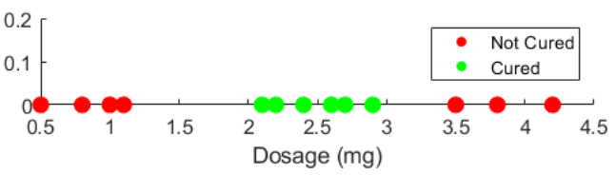
Support Vector Machines
Suppose we have the data of a drug dosage where the red dots represent patients that got not cured while the green dots represent those that got cured.
The data has lots of overlap
Basically what the data is pointing out is the fact that if the dosage is too little or too high the drug does not work. It will only work if the dosage is right.
How can we classify this problem?

Slide 65
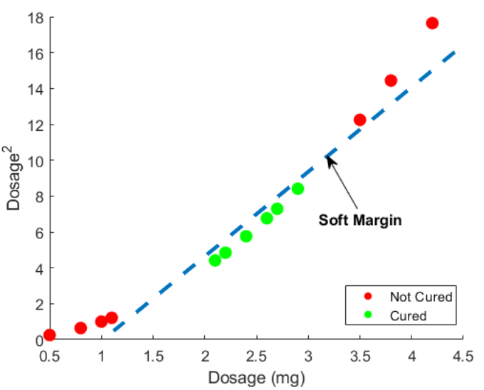
Support Vector Machines – The Kernel Trick
Transform the problem to a higher dimension by computing the values on the 𝑦 -axis as 𝑦=𝑓(𝑥)
We will use 𝑓(𝑥)=𝑥^2
Plotting the 2-D data we get the figure on right
We now can draw a support vector classifier to classify the data, this will help us in classifying the group of people who got cured and those who did not get cured.

Slide 66
Support Vector Machines – The Kernel Trick
Now we can classify any new observation by plotting it onto the new 2-D (i.e. at point (𝑥,𝑥2) ) and compare it with our soft classifier line. If it is above, the dosage will not cure and if it is below the patient will be cured.
In general, taking the data to a higher dimension may lead to better classification.
SVM can use several kernel functions to map data to higher dimensions such as the polynomial and radial functions.
We just have to try each one to find the best kernel for the considered data set
Decision boundary

Slide 67
Support Vector Machines – The Kernel Trick
1. Given a set of non-linearly separable points.
2. Transform the data using a kernel
3. Find a SVM classifier
4. Project back to original space

Slide 68
Advantages of SVMs
1. Regularization capabilities: SVM has good generalization capabilities which prevent it from over-fitting. 2. Handles non-linear data efficiently: SVM can efficiently handle non-linear data using Kernel trick. 3. Stability: A small change to the data does not greatly affect the hyperplane and hence the SVM. So the SVM model is stable.
4. Optimality: SVM has a nature of Convex Optimization which helps in finding globally best model.

Slide 69

Decision Boundary – Evaluation
Evaluation
Using a loss function - calculate how good or poorly our boundary performs

Slide 70


Decision Boundary – Evaluation
Evaluation
Using a loss function - calculate how good or poorly our boundary performs
Our objective is to minimize the loss

Slide 71
Decision Boundary – Evaluation
Evaluation
TP (True Positives) = examples that were correctly labeled as “1”
FN (False Negatives) = examples that should have been “1”, but were labeled as “0”
FP (False Positives) = examples that should have been “0”, but were labeled as “1”
TN (True Negative) = examples that were correctly labeled as “0”
Classified As:
Classified As:
 | 0 | 1
0 | TN | FP
1 | FN | TP
 | 0 | 1
0 | 12 | 2
1 | 2 | 14
Correct Label:
Correct Label:

Slide 72



Decision Boundary – Evaluation
F₁ score is the harmonic mean of precision and recall

Slide 73
Decision Boundary – Evaluation
Accuracy measure is not good when the data is imbalanced
Example: Consider that we are building a model to predict whether a pilot will land safely or crash. Assume that 90% of the given data represents that the pilot landed safely and 10% represents that he crashed.
Even when the model fails to predict any crashes, its accuracy could be 90%!

Slide 74
Decision Boundary – Evaluation
Low Precision, High Recall, and High Specificity
If the classifier predicts negative, you can trust it, the example is negative. However, pay attention, if the example is negative, you can’t be sure it will predict it as negative (specificity=78%).
If the classifier predicts positive, you can’t trust it (precision=33%). However, if the example is positive, you can trust the classifier (recall=100%).

Slide 75
Decision Boundary – Evaluation
High Precision, High Recall, and Low Specificity
Predicting everything as positive clearly can’t be a good idea. However, because the population is imbalanced the precision is relatively high, the recall is 100% because all the positive examples are predicted as positive. But the specificity is 0% because no negative example is predicted as negative.

Slide 76
Decision Boundary – Evaluation
High Precision, Low Recall, and High Specificity
If it predicts that an example is positive, you can trust it — it is positive. However, if it predicts it is negative, you can’t trust it, the chances are that it is still positive.

Slide 77
Decision Boundary – Evaluation
All the measures (precision, recall, and specificity) give us important information about how well is our classification model.
Recall is a better measure than precision when false-negatives are important
Example: For rare cancer data modeling, anything that doesn't account for false-negatives is bad.
Precision is a better measure than recall when false-negatives are not important
Example: For YouTube recommendations, false-negatives is less of a concern.

Slide 78
Decision Boundary – Cross-validation
Given a set of data with labels, how can we use it to build a machine learning model and evaluate its performance?
We need to do two things with this data:
Estimate the parameters of the machine learning model, i.e. use it to guess the shape of the decision boundary that best fits the data.
Parameters estimation is called Training the model.
Evaluate how well do the learned parameters work, i.e. we need to test how good a job will the decision boundary do when we present it with data it has never seen before.
Evaluating a method is called Testing the model.

Slide 79
Decision Boundary – Cross-validation
Therefore in Machine learning:
We need the data to train the machine learning model.
We need to test the trained model on data it hasn’t seen in training, to make sure that it generalizes well.
Question: where can we get training and testing data?
Using the same data for training and testing does not work since we do not know how the algorithm performs when it is given a set of data it has not been trained on.
Using all the data for training will not leave any data for testing

Slide 80

Decision Boundary – Cross-validation
Answer: Divide the collected labeled data into a training set and testing set.
A common practice in Machine Learning is to use 75% of the data for training and 25% of data for testing. This is called the holdout method
The question is which 25% to choose for testing and which 75% to choose for training?

Slide 81

Decision Boundary – Cross-validation
We use k-fold cross-validation method:
Break the training data into k equally sized subsets (folds)
Train the ML model on k-1 subsets (the training set)
Test the model on the remaining 1 set (the testing set)
Do this k times, each time testing on a different set
Calculate the average error over the k validation sets

Slide 82

Decision Boundary – Cross-validation
Example: a Four-Fold cross validation: the data is divided into FOUR equal sets as shown below:
We then train and test the Machine Learning algorithm as follows:
Sets 1,2,3 training and Set 4 for testing
Sets 1,2,4 training and Set 3 for testing
Sets 2,3,4 training and set 1 for testing
...etc (all possible combinations)
In practice, its is common to use 10-fold Cross validation.

Slide 83
Decision Boundary – Cross-validation
k-fold cross-validation can help us to obtain reliable estimates of the model’s generalization performance, that is, how well the model performs on unseen data.
But the main disadvantage is increased computational cost

Slide 84

Decision Boundary – Underfitting and Overfitting
Suppose we have the dataset as shown below
Data is labeled, red circles and blue circles
How can we train and obtain the best classifier?

Slide 85

Decision Boundary – Underfitting and Overfitting
Idea 1: Let us try a linear classifier represented by a straight line:
As can be seen that there are many blue points above the line that are misclassified
No matter how we rotate or shift the line, we will always have high misclassification rate in training and testing
This is known as Underfitting
Over simplifies the complexity in the data

Slide 86


Decision Boundary – Underfitting and Overfitting
Idea 2:
Let us use a curve that best can separate the red from the blue classes
Let us divide our data into training and testing as shown below

Slide 87

Decision Boundary – Underfitting and Overfitting
Idea 2:
We can find the "wavey" curve that best fits all the points in the training set as shown below:
Fits the varying training data very well

Slide 88

Decision Boundary – Underfitting and Overfitting
Idea 2:
Now if we use the curve to test with data we get the following:
As can be seen that many test points are not classified correctly.
This is what we call Overfitting
Does not do well with the testing data

Slide 89

Decision Boundary – Underfitting and Overfitting
Idea 3:
Allow for some misclassification and we can get:
This curve does not overfit nor underfit
There are some misclassifications but within an acceptable range
Notes:
Overfitting: low bias, high variance
Underfitting: high bias, low variance
Good balanced curve: low bias, low variance

Slide 90
Unsupervised Learning

Slide 91

Unsupervised Learning
Unsupervised Learning
Given input data without feedback, the goal is to learn patterns
No feedback means …
Unlike supervised learning, the data is not labeled
Unlike reinforcement learning, no reward/punishment
Example: Unlabeled data
Question: What patterns can be learned from this data?

Slide 92
Unsupervised Learning
The Clustering Problem
Organizing a set of objects into groups in such a way that similar objects fall in the same group
Some Clustering Applications
Market research
Image segmentation
Medical imaging
Social network analysis.
Genetic research

Slide 93
Unsupervised Learning - k-means Clustering
k-means Clustering
An algorithm divides all of our data points into k different clusters
Clustering data based on repeatedly assigning points to clusters and updating those clusters' centers
k: a parameter indicating the number of clusters
Unknown – requires experimentation

Slide 94

k-Means Clustering - Example
Step 1
Suppose we want 3 clusters, i.e. 𝑘 = 3
Initially, we choose 3 random centers of those 3 clusters
The 3 centers are indicated with Blue, Red and Green diamonds.
Center of a cluster represents the mean of that cluster

Slide 95

k-Means Clustering - Example
Step 2
Next, assign every point to a cluster based on which cluster center it is closest to
These will be the initial clusters based on our first initial random centers
Question: How can we improve?

Slide 96

k-Means Clustering - Example
Step 3
Re-compute the centers (means) of the clusters

Slide 97

k-Means Clustering - Example
Step 4
Re-assign points based on the new centers (means) of the clusters

Slide 98

k-Means Clustering - Example
Step 5
Re-compute the centers (means) of the clusters
Algorithm repeats ..
Re-assigning point to closest centers
Re-computing centers (means)
Eventually ..
There will be no changes and algorithm stops

Slide 99

k-Means Clustering - Example
Final Clusters …
Shown the final clusters ..

Slide 100
Reinforcement Learning
semi-supervised learning

Slide 101

Reinforcement Learning
Building an AI agent that learns from experience
Agent can be physical (e.g., Robot) or a program
The agent is put in an environment, in which it learns from its actions
When the agent takes an action, it moves to a new state
For every action, there is a reward or punishment,
Agent learns what to do and what not to do in the future actions

Slide 102


Reinforcement Learning
Examples: Robots learning to walk
Robot learns through reward or punishment
https://www.youtube.com/watch?v=3gi6Ohnp9x8
https://www.youtube.com/watch?v=Rdm2ggtFvmQ
https://www.youtube.com/watch?v=goxCjGPQH7U

Slide 103


Reinforcement Learning - Markov Decision Process
Markov Decision Process (MDP): a formal method to model decision-making, representing states, actions, and their rewards
Set of states: S - circles
Set of actions: ACTIONS(s) – arrows
Transition model P(s' | s, a)
What is the probability P of going to state s’, if agent is in state s taking action a
Reward function R(s, a, s')
reward of going from state s to s’ after taking action a

Slide 104

MDP: Key Concepts
Policy :
A policy $π$ is mapping from states to actions $π\left(s\right):S→ 𝒜$
A policy fully defines the behavior of an agent
MDP policies depend on the current state (not the history)
The return 𝐺^{𝑡},
The total future reward
The state-value function $V^{π}\left(s\right)$:
The expected return starting from state s and following the policy 𝜋
Based on the table on the right, we can tell that it is good for the agent to be in state 2
The action-value function, 𝑞^{𝜋} (𝑠,𝑎), called Q function:
The expected return starting from state s, taking the action a, and following the policy 𝜋.
Based on the table on the right, performing action 1 in state 1 and action 2 in state 2 are the better options as they have higher values than other actions
State | Value
State 1 | 0.3
State 2 | 0.9
State | Action | Value
State 1 | Action 1 | 0.03
State 1 | Action 2 | 0.02
State 2 | Action 1 | 0.5
State 2 | Action 2 | 0.9

Slide 105




Reinforcement Learning - Markov Decision Process
Example: Simulated 4 x 4 world navigated by a robot
Robot
Goal - green room
Agent receives reward
Bad places- red rooms
Agent receives punishment
Initially, the agent does not know what’s good or bad!

Slide 106
Reinforcement Learning - Markov Decision Process
Good action – take in future
Example: Simulated 4 x 4 world navigated by a robot
Robot
Goal - green room
Agent receives reward
Bad places- red rooms
Agent receives punishment
Initially, the agent does not know what’s good or bad!
Bad actions – avoid in future

Slide 107
Reinforcement Learning - Q-learning method
Good action – take in future
Q-learning method
Method for learning a function Q(s, a), representing estimate of the reward value of performing action a in state s
Initially, Q(s, a) is unknown – but values are learned through trying different actions in different states
Bad actions – avoid in future

Slide 108
Reinforcement Learning - Q-learning method
Good action – take in future
Q-learning Overview
Start with Q(s, a) = 0 for all s, a
When we take an action and receive a reward:
Estimate the value of Q(s, a) based on current reward and expected future rewards
For future rewards, rewards of taking a later action
Update Q(s, a) to take into account old estimate as well as our new estimate
Bad actions – avoid in future

Slide 109

Reinforcement Learning - Q-learning method
Good action – take in future
Q-learning
α is the learning rate [0,1]
Controls how Q-function is updated
Large α means we value new information more than old information
Bad actions – avoid in future

Slide 110

Reinforcement Learning - Q-learning method
Good action – take in future
Q-learning
Old value estimate = Q(s, a)
What is the “new value estimate”?
Bad actions – avoid in future

Slide 111

Reinforcement Learning - Q-learning method
Good action – take in future
Q-learning
New value estimate:
reward r received after taking action a
expected future reward estimates from this state onwards
Bad actions – avoid in future

Slide 112

Reinforcement Learning - Q-learning method
Good action – take in future
Q-learning
Future reward estimates:
max_{a'} Q(s', a')
maximum value across all possible actions a’ taken from next state s’
Bad actions – avoid in future

Slide 113

Reinforcement Learning - Q-learning method
Good action – take in future
Q-learning
Future reward estimates (variation):
ϒ is parameter controlling how future rewards are valued over current rewards
Bad actions – avoid in future

Slide 114
Reinforcement Learning - Q-learning method
Good action – take in future
Greedy Decision-Making Policy
After training …
When in state s, choose action a with highest Q(s, a)
Is this the best policy? Why?
Bad actions – avoid in future

Slide 115
Reinforcement Learning - Q-learning method
Greedy Decision-Making Policy
May not be the best policy
Consider the shown two paths
May choose the longer path over the short path
Never tried the top path

Slide 116

Reinforcement Learning - Q-learning method
ε-Greedy Decision-Making Policy
Explore vs. Exploit
Exploit: take the move with best reward
Explore: try random move –if it may later give better reward

Slide 117
Q-learning Numerical Example
Let us consider a game that has 6 states {A, B, C, D, E, F}. We can start at any state but the game ends when we reach to state F.
Let us assume that α=1 and ϒ=0.8
Initially the Q matrix will be set to 0
Let us assume the following reward matrix R
A dash (-) in the matrix means that it is not possible to go from a state to another state

Slide 118
Q-learning Numerical Example
Let us assume that we start at state B.
Looking at the 2nd row of matrix R, there are two possible actions for the current state B, to go to state D or state F.
Let us assume that by random selection, F is selected.
Now let us consider that we are in state F. From state F, there are 3 possible actions to go to state B, E or F.

Slide 119
Q-learning Numerical Example
Q(state,action) = R(state,action)+ ϒ Max[Q(next state, all actions)]
Q(B,F) = 100 + 0.8 Max[Q(F,B), Q(F,E), Q(F,F)] = 100 + 0.8 * 0 = 100
Note that since Q matrix is initially 0, Q(F,B)=Q(F,E)=Q(F,F)=0
The next state F becomes the current state. Since F is the goal state, the game ends and the agent now contains the following updated Q matrix

Slide 120
Q-learning Numerical Example
For the next game, let us assume that we started at state D.
From D, there are 3 possible actions to go to B, C or E.
Let us assume that by random selection, we selected B.
W need to compute Q(D,B)
Q(D,B) = R(D,B) + 0.8 Max[Q(B,D), Q(B,F)] = 0 + 0.8*100 = 80
The Q matrix gets updated as shown.

Slide 121
Q-learning Numerical Example
The next state B becomes the current state.
From B we can go either to D or F. Let us assume that we selected F.
Q(B,F) = 100 + 0.8 Max[Q(F,B), Q(F,E), Q(F,F)] = 100 + 0.8 * 0 = 100
The result does not change the Q matrix.

Slide 122
Q-learning Numerical Example
If our agent learns more through playing many more games, it will finally reach convergence values of Q matrix as shown.
The Q matrix can be then normalized by dividing valid entries by the maximum value as shown
Using the Q matrix, the agent can reach the goal in an optimum way.

Slide 123
Reinforcement Learning - Example
Playing Games
Common application of reinforcement learning is in game playing
Let the AI agent play a game many times
Reward received when the game is over – wining (+1) or losing (-1)
The AI agent eventually learns how to play the game

Slide 124

Reinforcement Learning - Example
Nim Game
2-players game
Piles (rows) of objects
At each turn, a player removes one or more objects from one pile
The player who removes the last object loses!
State: is a tuple of remaining piles, e.g. (1, 1, 4, 4)
Action (i, j): represents the action of removing j items from pile i
Demo
nim folder
Modify the file (play)
Watch video

Slide 125
Machine Learning Summary
Supervised Learning
Labelled data (instructive feedback)
Classification
Reinforcement Learning
Rewards (evaluative feedback)
Playing games
Unsupervised Learning
Unlabeled data (no feedback)
clustering

Slide 126
Credit and References
CS50’s Introduction to Artificial Intelligence with Python
https://www.youtube.com/watch?v=efR1C6CvhmE
https://www.youtube.com/watch?v=_YPScrckx28
https://www.youtube.com/watch?v=ny1iZ5A8ilA
https://people.revoledu.com/kardi/tutorial/ReinforcementLearning/Q-Learning-Example.htm

